Slide 1
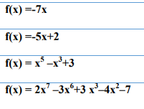
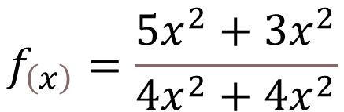

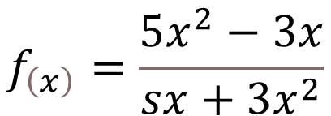


$$f_{\left(x\right)}=\left(3x+2\right)\left(5x+3\right)$$
$$f_{\left(x\right)}=\left(x^{2}+25\right)\left(x^{2}−25\right)$$
$$f_{\left(x\right)}=\left(x^{2}+x\right)\left(x^{2}+x\right)$$
$$f_{\left(x\right)}=\left(2x^{2}+x\right)\left(5x^{3}+3x^{2}−x\right)$$
$$f_{\left(x\right)}=\frac{5x^{2}−3x}{sx+3x^{2}}$$
$$f_{\left(x\right)}=\frac{5x^{2}+3x^{2}}{4x^{2}+4x^{2}}$$

Slide 2




$$f_{\left(x\right)}={\left(4x+3x^{2}\right)}^{3}$$
$$f_{\left(x\right)}={\left(x+4\right)}^{5}$$
$$f_{lx}=ⅇ^{6x}$$
$$f_{\left(x\right)}=\ln\left(10x^{2}\right)$$

